Slide 1
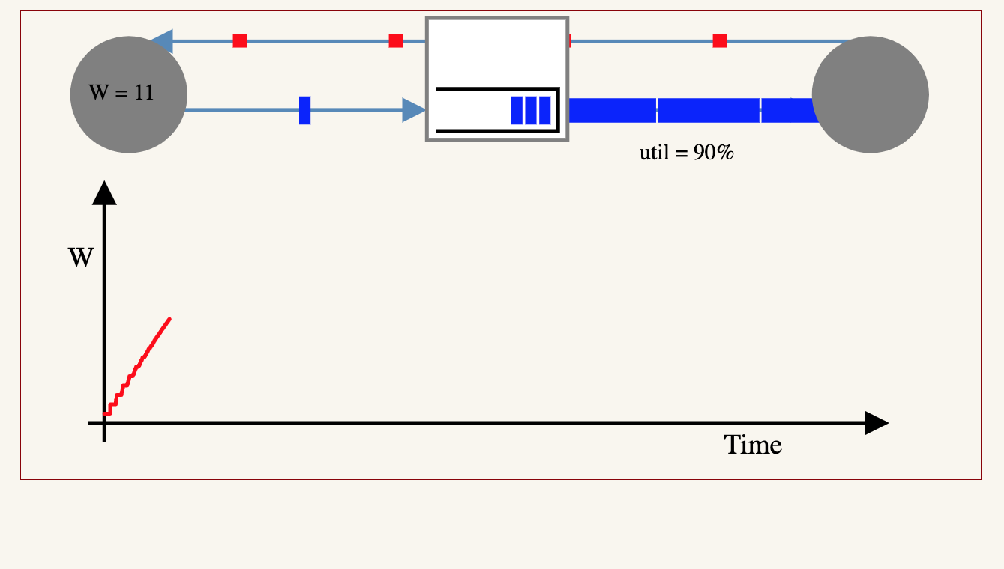

Slide 2
Why this meeting?
Background
Research papers on experiments and theories of buffer size.
Yet, no universal agreement on how big router buffers should be, and why.
Personal confession: I have no idea what the general answer is
  Incast
  Data centers
  For specific environments, like financial networks, SLAs, HPC, …
Our goal
A workshop in October/November 2019: “How Big Should Buffers be in Switches and Routers?”
Measurements: Invite operators of large networks to perform experiments in their networks.
Theory: Invite researchers to develop theory explaining, supporting (challenging?) measurements.
Report results publicly at workshop.
Compare notes and write a report together, sharing our results to the world.

Slide 3
Organizers
Neda Beheshti
Christophe Diot
Tom Edsall
Nasser El-Aawar
Yashar Ganjali
Nick McKeown
Bruce Spang
Local logistics:
Andi Villanueva

Slide 4
Who we are
Speakers from 14 companies and 2 universities
  Network operators, cloud companies, router vendors, chip vendors
Attendees from 22 companies and 2 universities
Let’s introduce ourselves…

Slide 5
Schedule for the day
10.30am – 1.30pm
Session 1: Network Operators
Neda Beheshti Facebook
Lincoln Dale Google
TY Huang Netflix
Honqqiang Liu Alibaba
Ken Duell AT&T
Joel Jaeggli Fastly
[12.00 – 12.30 Lunch]
Simon Leinen Switch
Bob Briscoe CableLabs
Chuanxiong Guo Bytedance
Igor Gashinsky Oath
1.45pm – 2.45pm
Session 2: Technology Providers
Parvin Taheri Cisco
Francois Labonte Arista
Golan Schzukin Dune/BCM
Chang Kim Barefoot
3.00pm – 4.00pm
Session 3: Discussion
  Conclusions Neda, Bruce, Nasser
  Actions and Next Steps Yashar, Nick

Slide 6
A brief history of buffer size

Slide 7
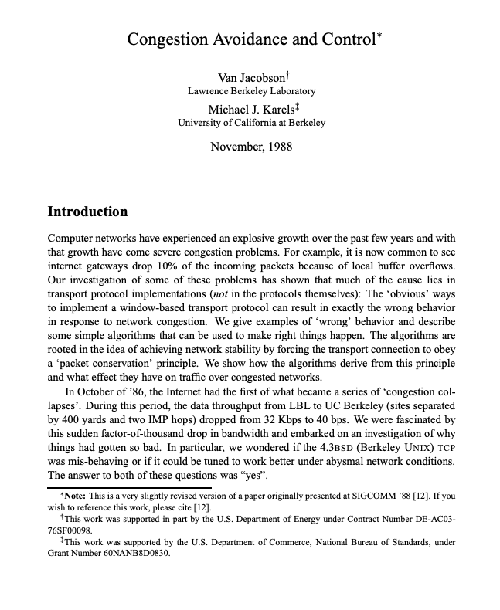
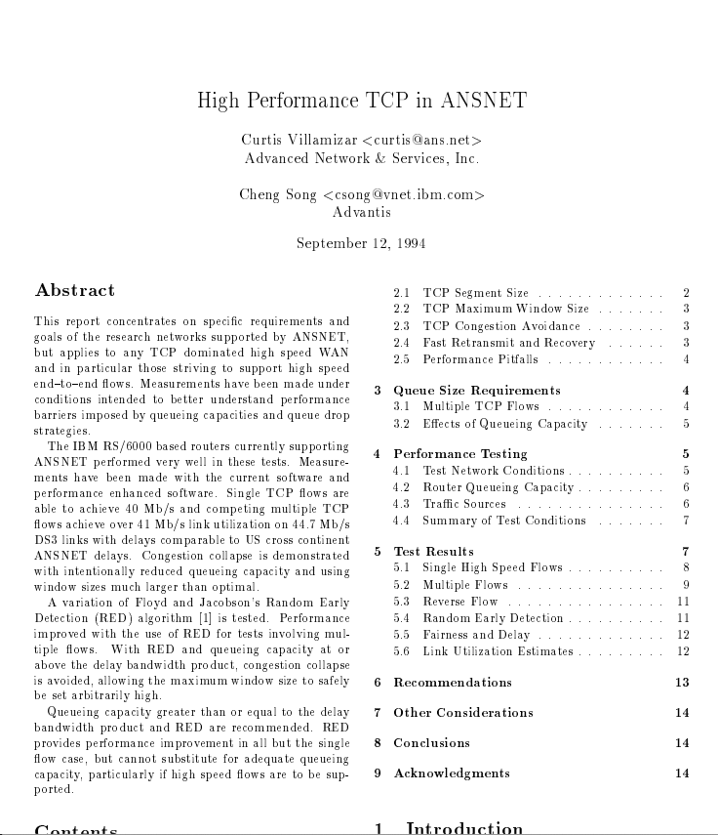





1988
1994
2019
Congestion Avoidance
and Control
VJ & MK
High Performance
TCP in ANSNET
CV & CS
$$B=2T×C$$
“Buffer size should equal
the bandwidth delay product”
$$Max RTT=2T+B/C=4T$$
$$Max RTT=2T+4B/C=10T$$
B
A
C
B
$$Min RTT=2T$$

Slide 8
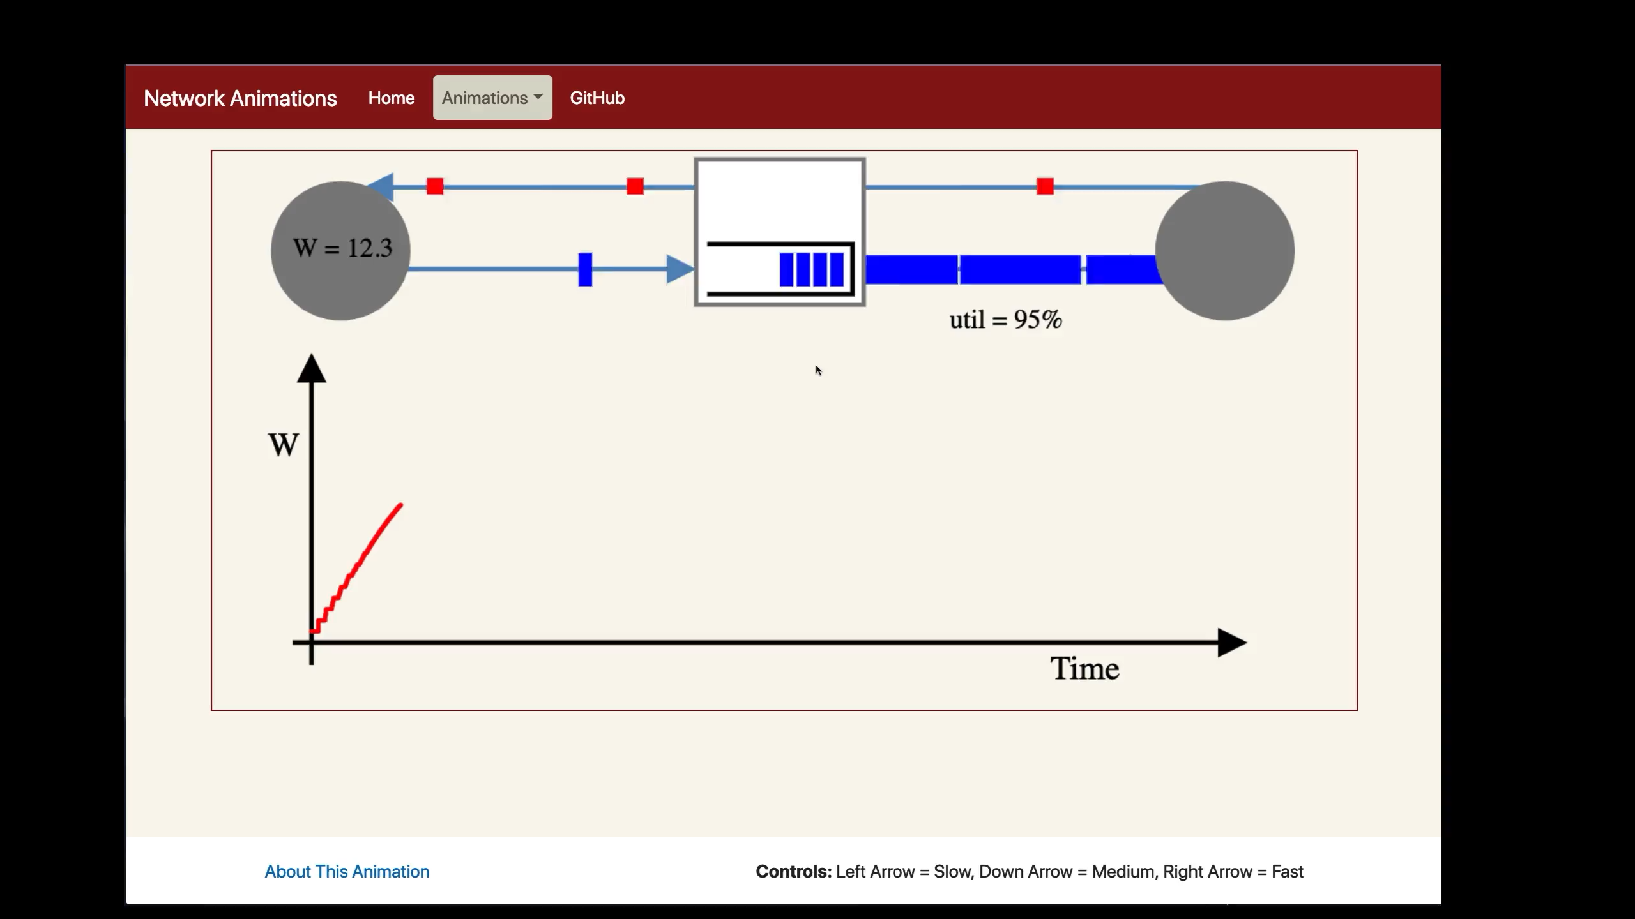

Slide 9


cwnd
B
A
C
B
time
2T
cwnd
$$\hat{W}$$
$$\frac{\hat{W}}{2}$$
t
time

Slide 10

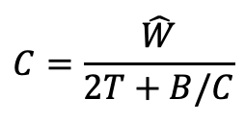


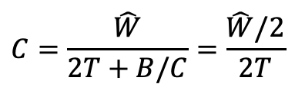





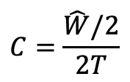
cwnd
B
A
C
B
time
2T
cwnd
$$C=\frac{\hat{W}}{2T+B/C}$$
1
$$\hat{W}$$
1
$$RTT= 2T+\frac{B}{C}$$
1
$$2T+\frac{5}{C}$$
1
$$2T+\frac{4}{C}$$
$$C=\frac{\hat{W}}{2T+B/C}=\frac{\hat{W}/2}{2T}$$
1
$$2T+\frac{3}{C}$$
1
$$2T+\frac{2}{C}$$
$$B=2T×C$$
$$\frac{\hat{W}}{2}$$
1
$$2T+\frac{1}{C}$$
$$RTT= 2T$$
$$C=\frac{\hat{W}/2}{2T}$$
2
t
time

Slide 11
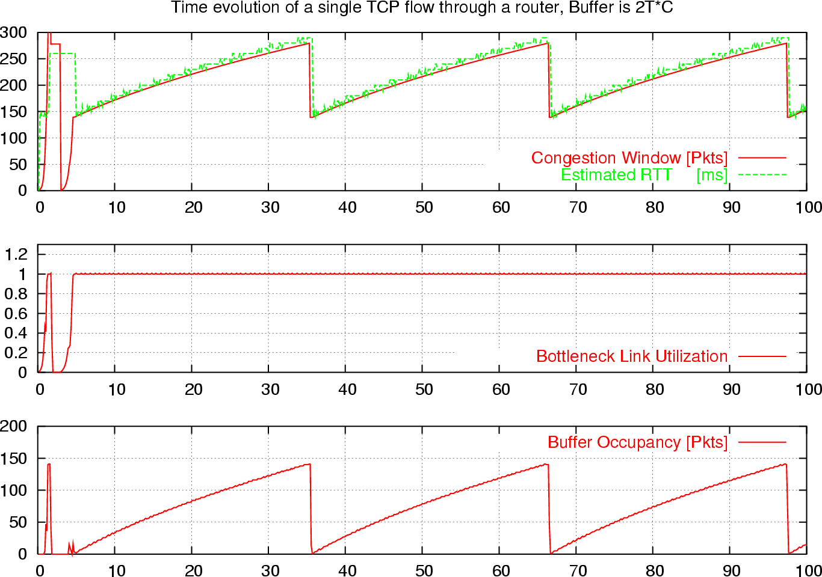
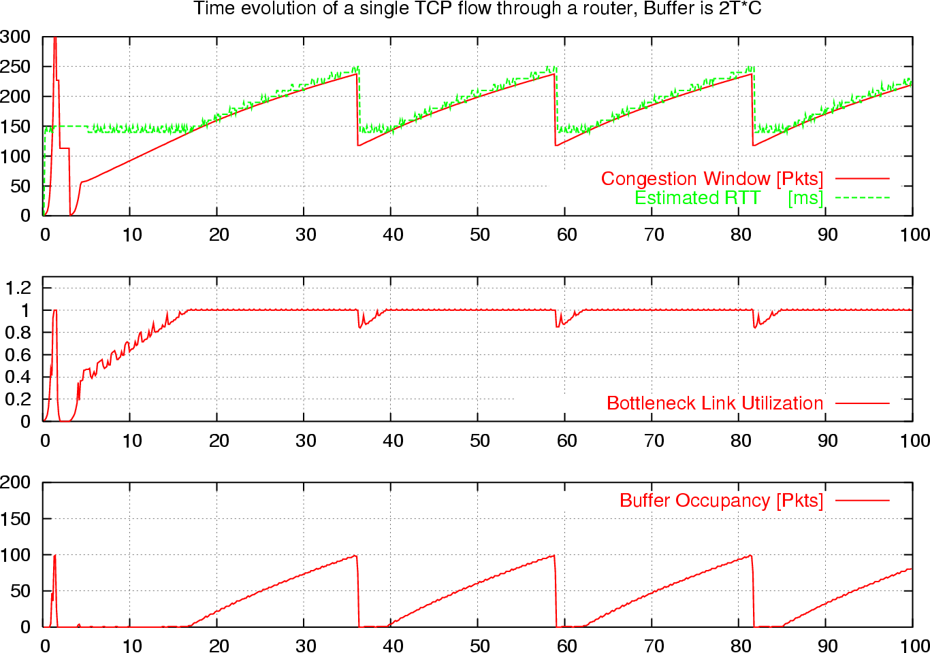


Time Evolution of a Single TCP Flow
B
A
C
B
2T
$$B=2T×C$$
$$B<2T×C$$

Slide 12
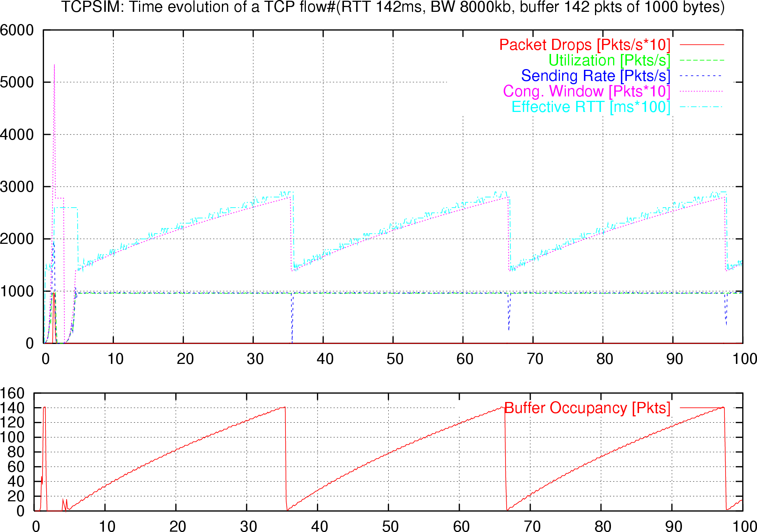
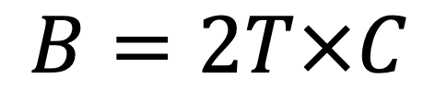
$$B=2T×C$$
B
A
C
B
Interval magnified
on next slide
2T
cwnd
RTT
time (ms)

Slide 13
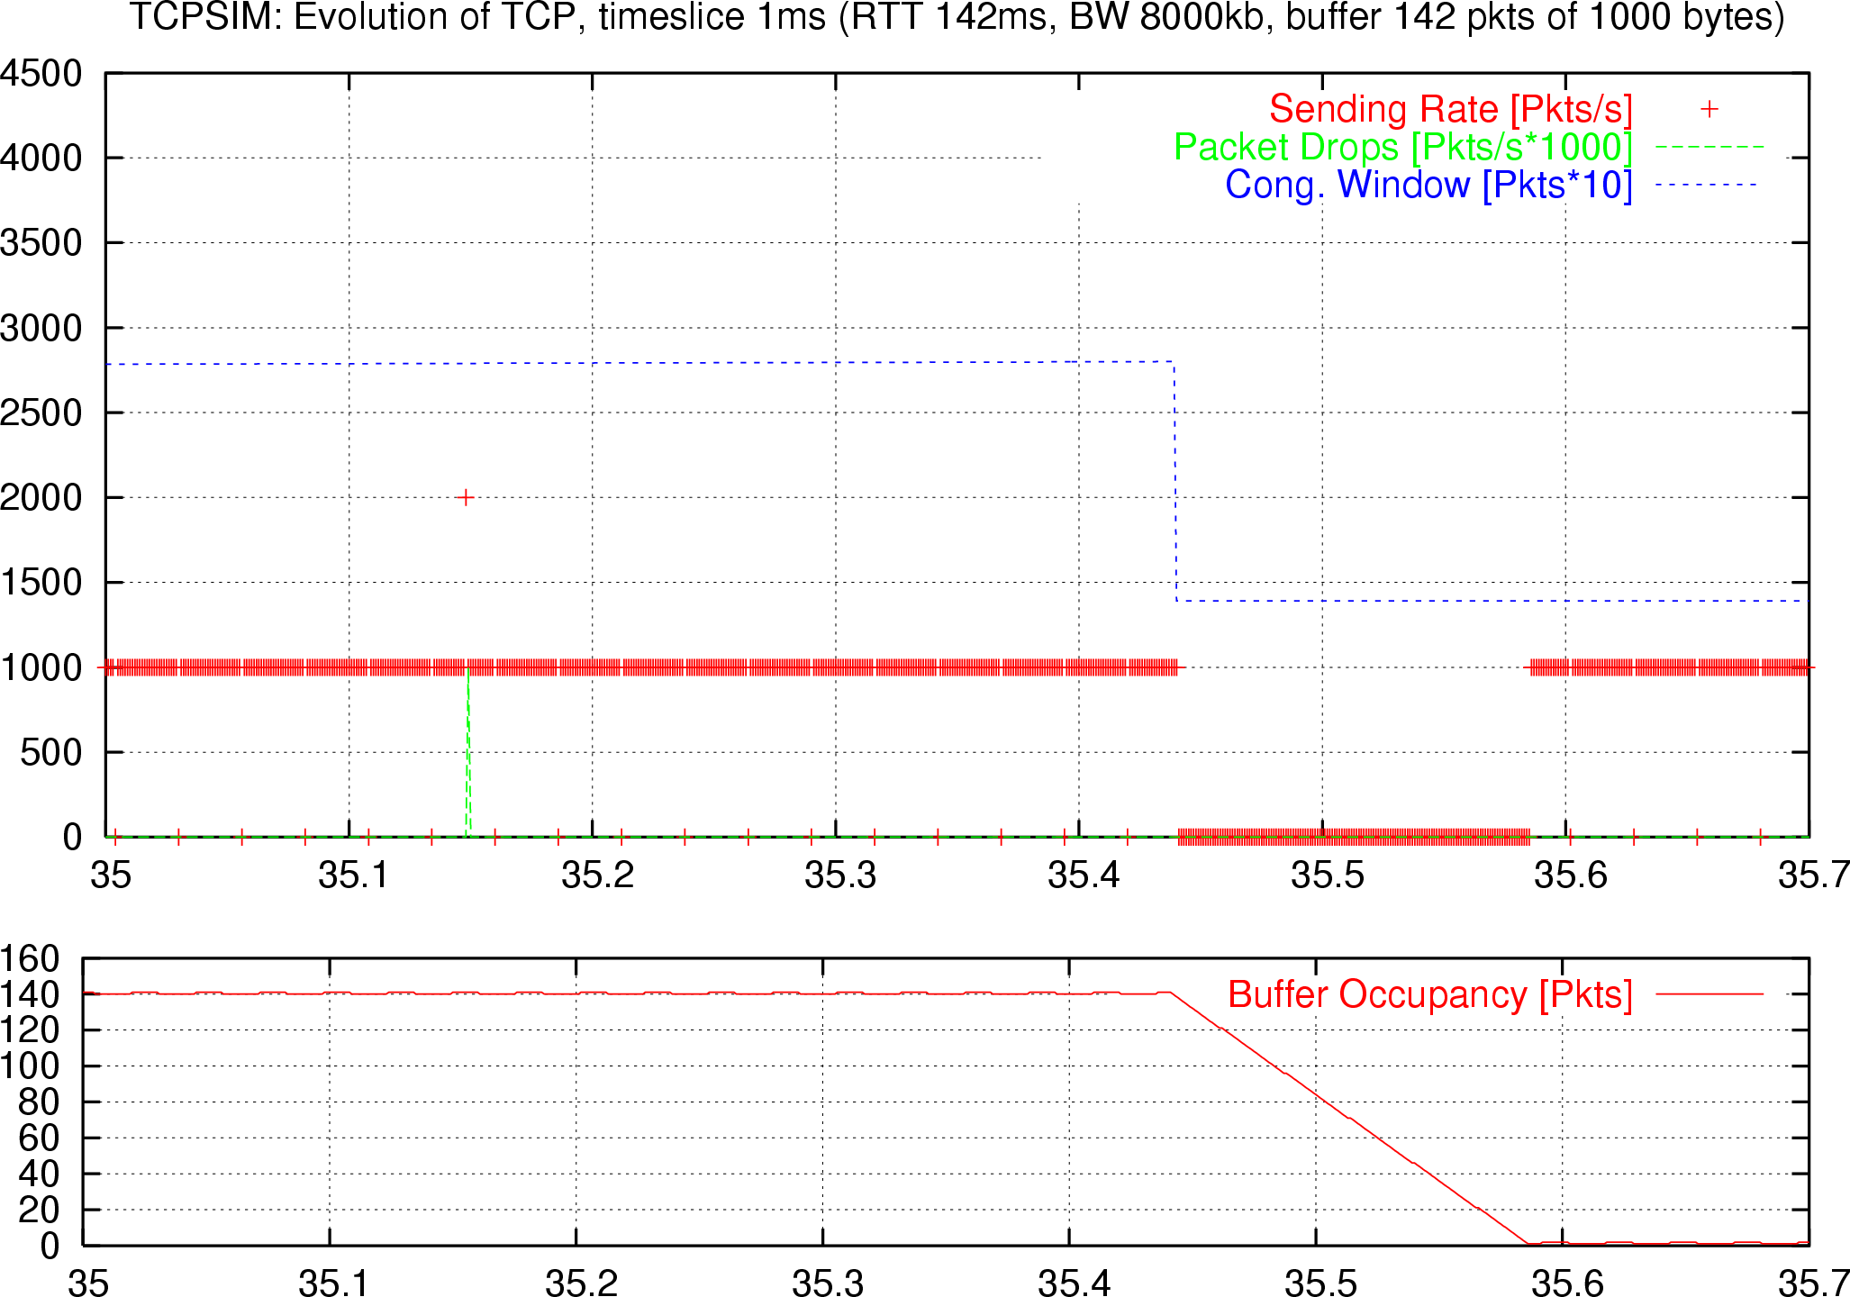
$$B=2T×C$$
B
A
C
B
Zoom View
2T
cwnd
Drop
Sending rate
one RTT
When sender pauses, buffer drains

Slide 14
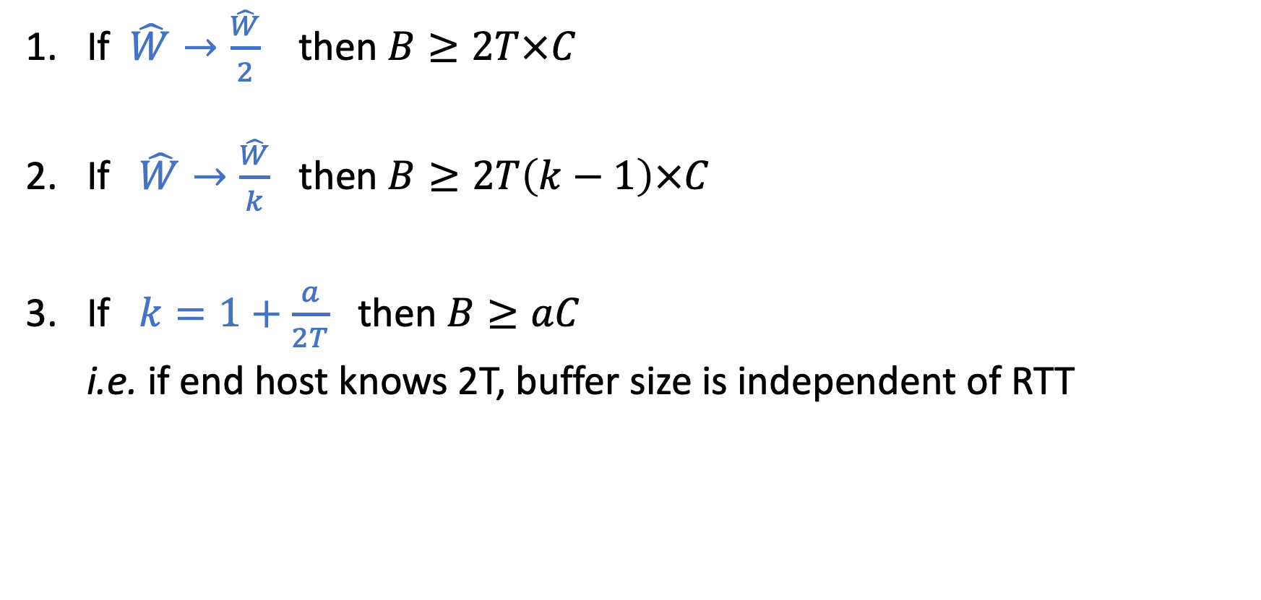
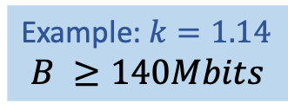
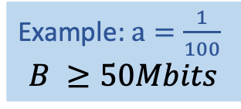
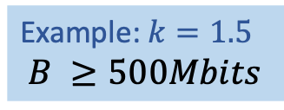
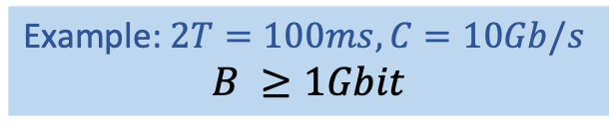
Single AIMD flow: 100% Throughput
If $\hat{W}→\frac{\hat{W}}{2}$ then $B≥2T×C$
If $\hat{W}→\frac{\hat{W}}{k}$ then $B≥2T\left(k−1\right)×C$
If $k=1+\frac{a}{2T}$ then $B≥aC$
i.e. if end host knows 2T, buffer size is independent of RTT
Example: $2T=100ms, C=10Gb/s$
$$B ≥1Gbit$$
Example: $k=1.5$
$$B ≥500Mbits$$
Example: $k=1.14$
$$B ≥140Mbits$$
Example: $a=\frac{1}{100}$
$$B ≥50Mbits$$

Slide 15
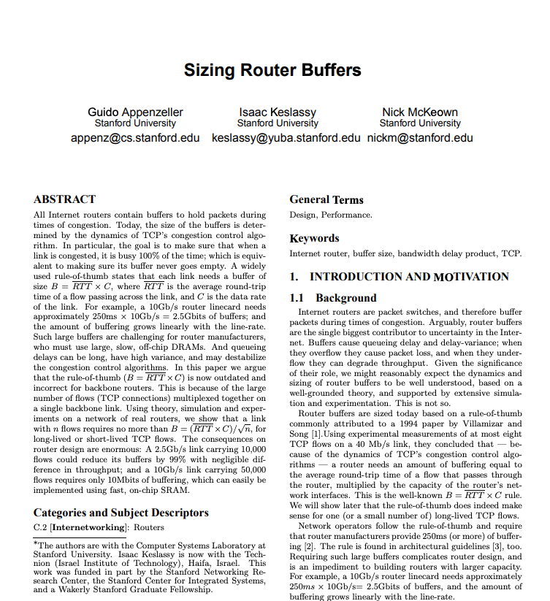


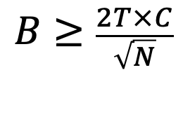
1988
1994
2004
2020
Congestion Avoidance
and Control
VJ & MK
High Performance
TCP in ANSNET
CV & CS
Sizing Router
Buffers
GA, IK, NM
$$B≥\frac{2T×C}{\sqrt{N}}$$
where N is the number of long-lived flows
$$B=2T×C$$
B
A
C
B
$$Min RTT=2T$$

Slide 16

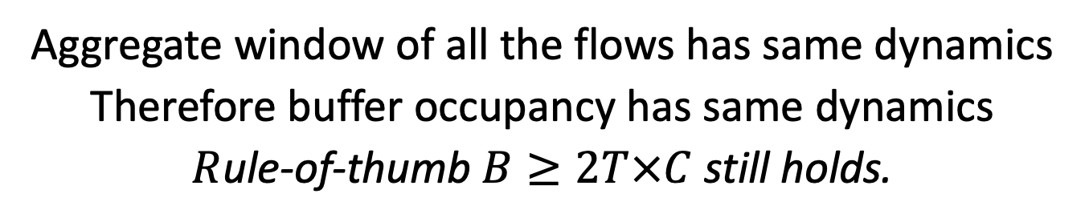
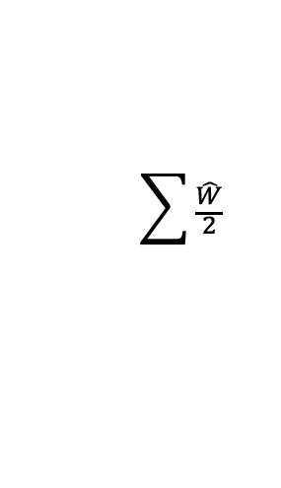
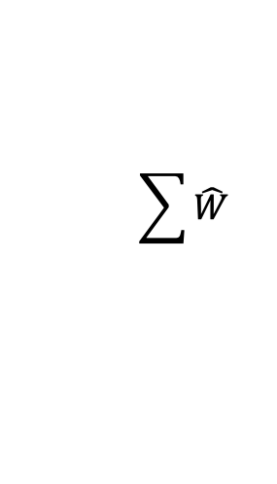


Synchronized Flows
B
C
A
B
2T
$$\sum{\hat{W}}$$
$2T×C$
$$\sum{\frac{\hat{W}}{2}}$$
$$\hat{W}$$
$$\frac{\hat{W}}{2}$$
t
Aggregate window of all the flows has same dynamics
Therefore buffer occupancy has same dynamics
$R$ule-of-thumb $B≥2T×C$ still holds.

Slide 17
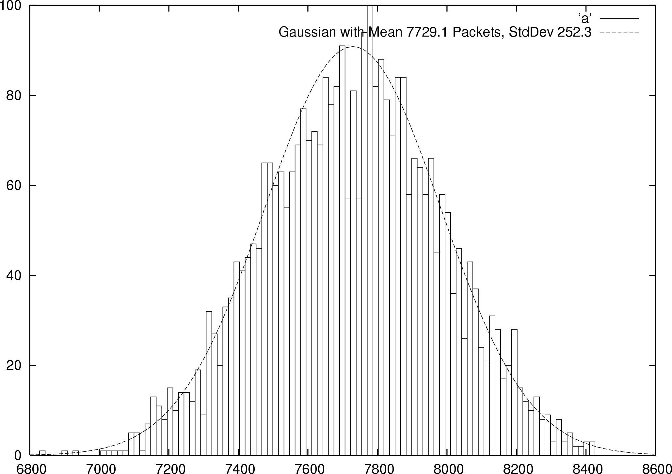
Desynchronized TCP Flows
Buffer Size
Probability
Distribution

Slide 18
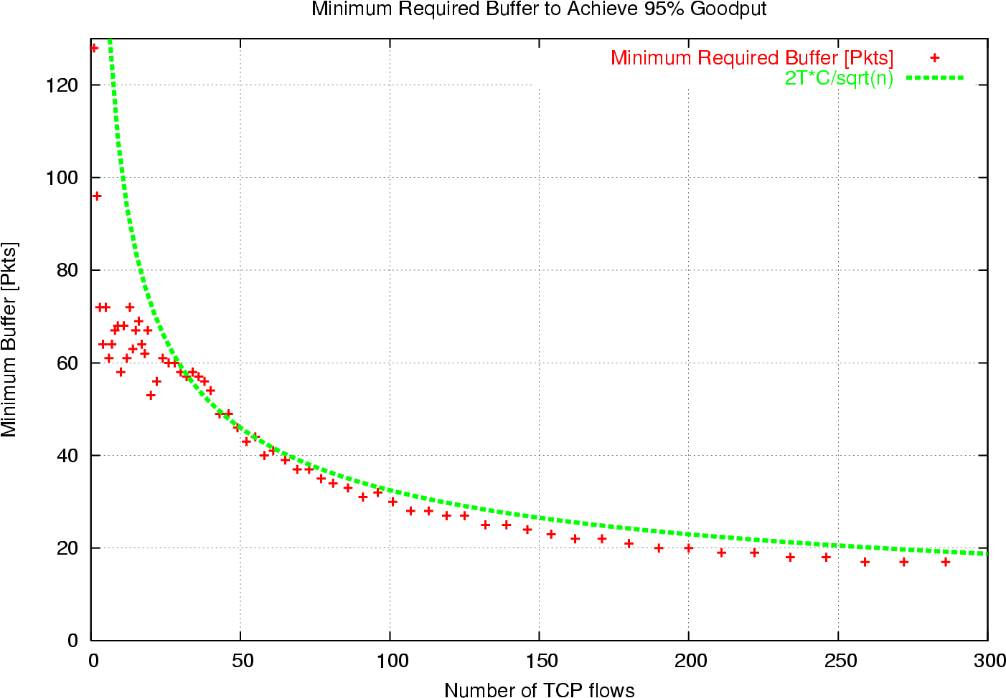
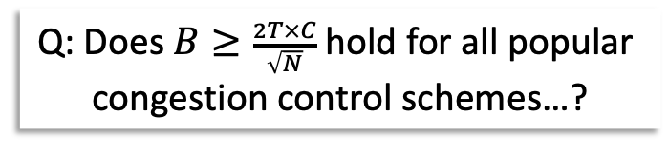
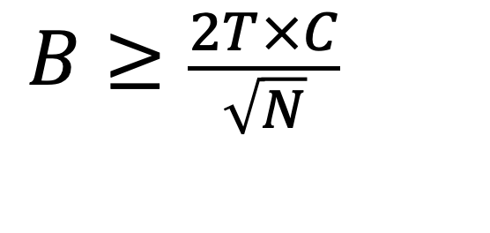

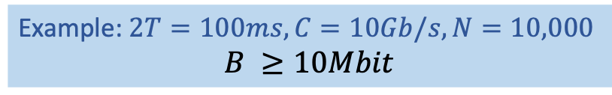
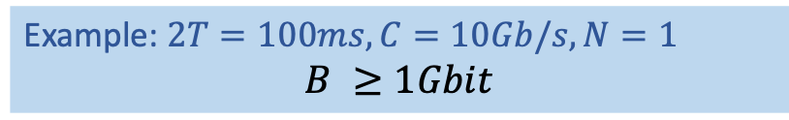
Many AIMD flows: 100% Throughput
Example: $2T=100ms, C=10Gb/s, N=1$
$$B ≥1Gbit$$
$$B≥\frac{2T×C}{\sqrt{N}}$$
Example: $2T=100ms, C=10Gb/s, N=10,000$
$$B ≥10Mbit$$
$$\frac{2T×C}{\sqrt{N}}$$
Q: Does $B≥\frac{2T×C}{\sqrt{N}}$ hold for all popular
congestion control schemes…?

Slide 19
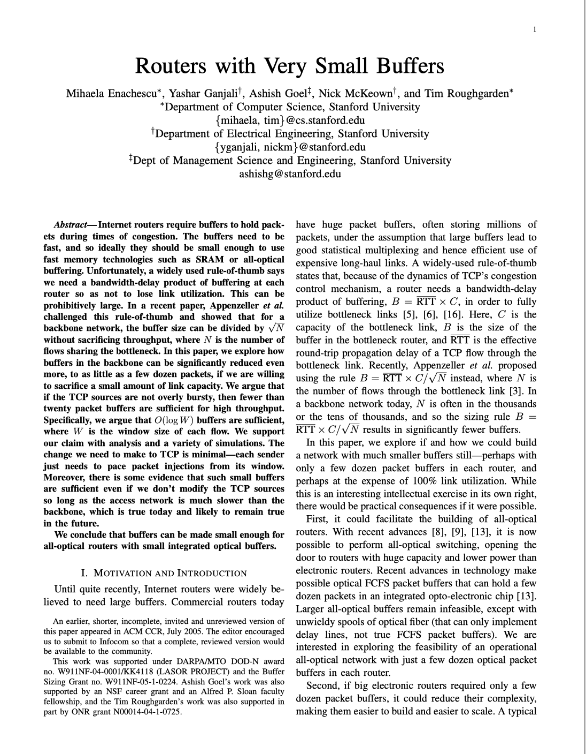
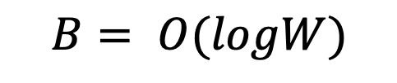
1988
1994
2004
2006
2020
Congestion Avoidance
and Control
VJ & MK
High Performance
TCP in ANSNET
CV & CS
Sizing Router
Buffers
GA, IK, NM
Routers with
Very Small Buffers
ME, YG, AG, NM, TR
$$B= O(logW)$$
1. Paced Traffic
2. Link utilization < 80%
Assumptions
$$B=2T×C$$
20-50 packet buffers,
all-optical routers.
Consequences
B
A
C
B
$$Min RTT=2T$$

Slide 20
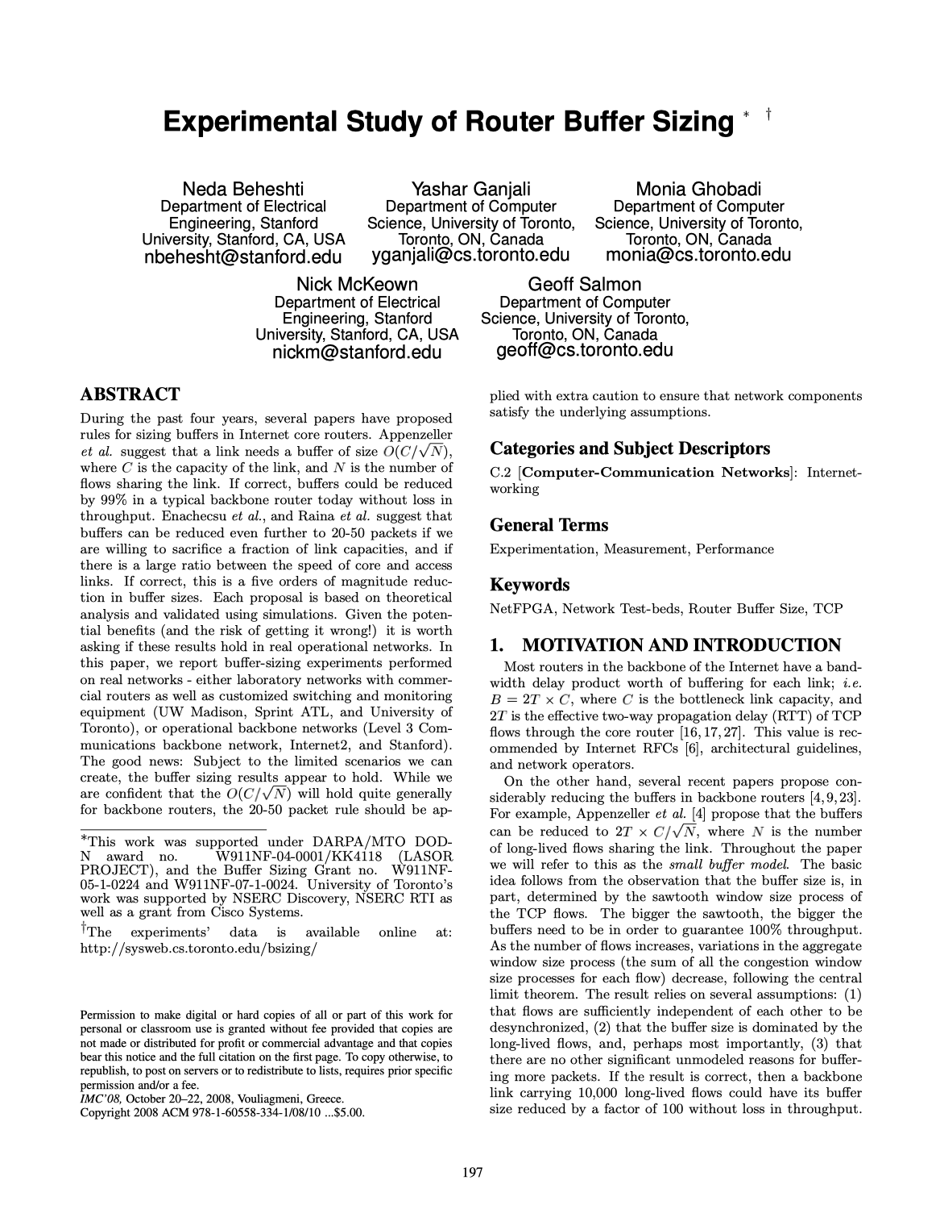
1988
1994
2004
2006
2008
2020
Congestion Avoidance
and Control
VJ & MK
High Performance
TCP in ANSNET
CV & CS
Sizing Router
Buffers
GA, IK, NM
Routers with
Very Small Buffers
ME, YG, AG, NM, TR
Experimental Study of
Router Buffers
NB, YG, MG, NM, GS
$$B=2T×C$$
B
A
C
B
$$Min RTT=2T$$

Slide 21
Buffer Sizing Experiments Are Challenging
Testbed experiments:
Generate realistic traffic with high accuracy
Explore a very large space (load, traffic shape, …)
Real network experiments:
Packet drops may violate SLAs
Adjusting buffers not straight forward (device limitations)
Both:
Accurate measurement of performance metrics not straight forward

Slide 22
Buffer Sizing Experiments
Small Buffers
  Stanford University dorm network
  University of Wisconsin
  Internet2
  Level 3 Communications
Tiny Buffers
  Internet2
  Sprint Advanced Technology Lab
  University of Toronto

Slide 23
Level 3 Communications Experiments
High link utilization
Long duration (about two weeks)
Buffer sizes 190ms (250K packets), 10ms (10K packets), 2.5ms (2500 packets), 1ms (1000 packets)
Load balancing over 3 links (2.5 Gb/s each)

Slide 24
Drop vs. Load, Buffer = 190ms, 10ms
Max Util = 96%

Slide 25
Drop vs. Load, Buffer = 1ms

Slide 26
Relative Link Utilization

Slide 27
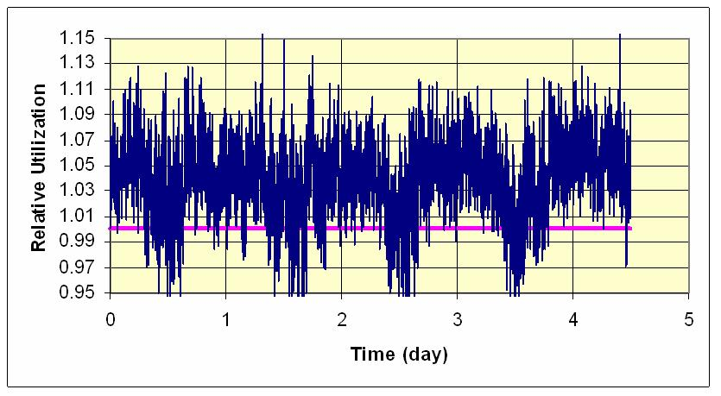
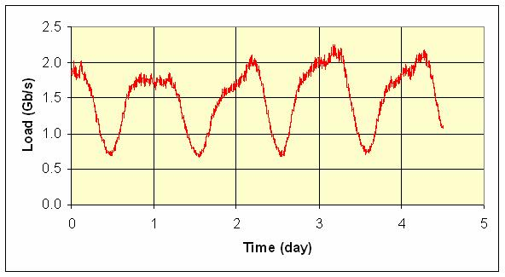
Relative Link Utilization
Load with 2.5ms buffers / load with 190ms buffers

Slide 28
Buffer Sizing Experiments
Small Buffers
  Stanford University dorm network
  University of Wisconsin
  Internet2
  Level 3 Communications
Tiny Buffers
  Internet2
  Sprint Advanced Technology Lab
  University of Toronto

Slide 29
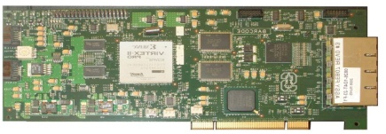
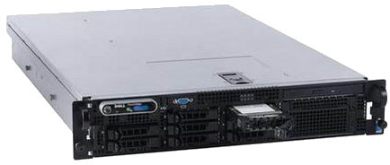
Tiny Buffers Experiments
Network of NetFPGA-based switches (20-100 machines)
  4 GigE interfaces
  Programmable
Accurate packet injections
Complete TCP stack
Accurate buffer size control
No hidden buffers
Added feature to measure queue occupancy time series

Slide 30
Experiment Results
We measured:
  Throughput
  Flow completion times
  Packet drop rates
  ...
For various combinations of:
  Input traffic
  Delays
  Buffer sizes
  ...

Slide 31
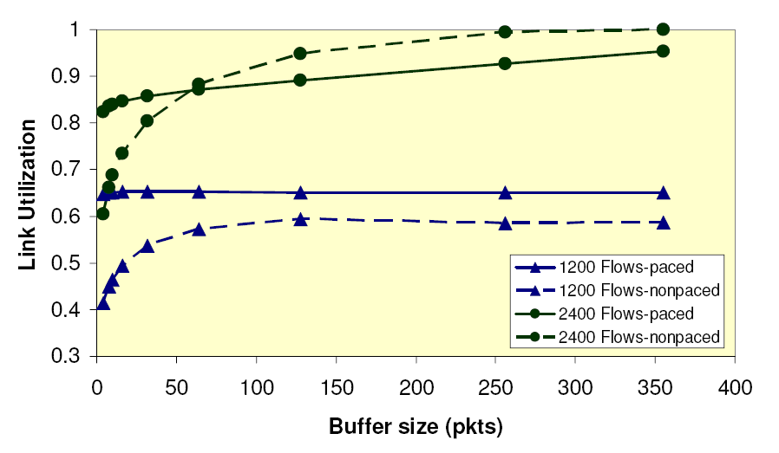
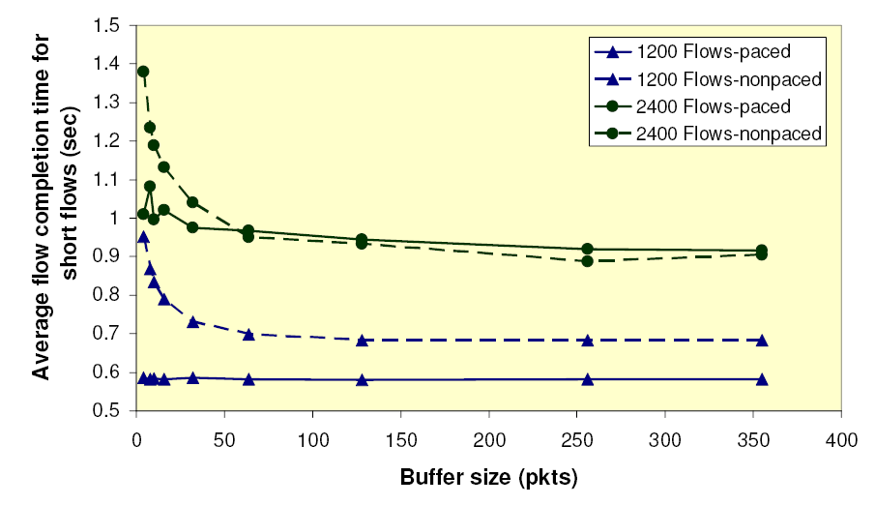
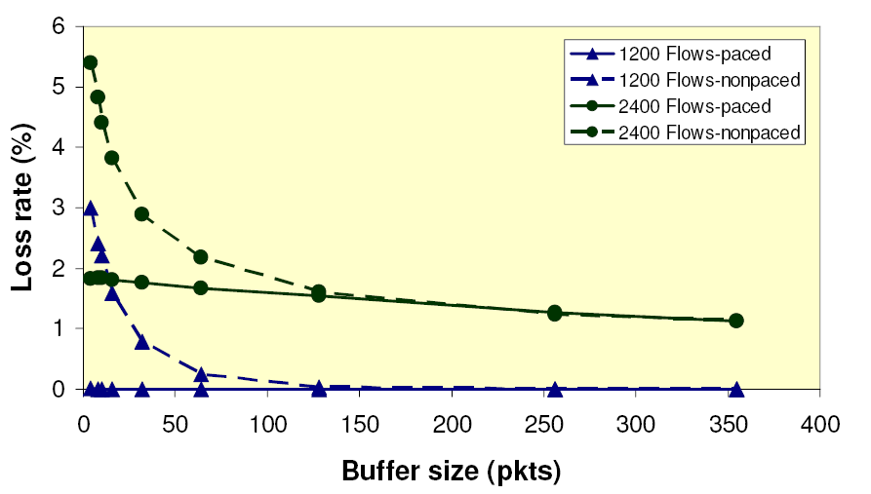
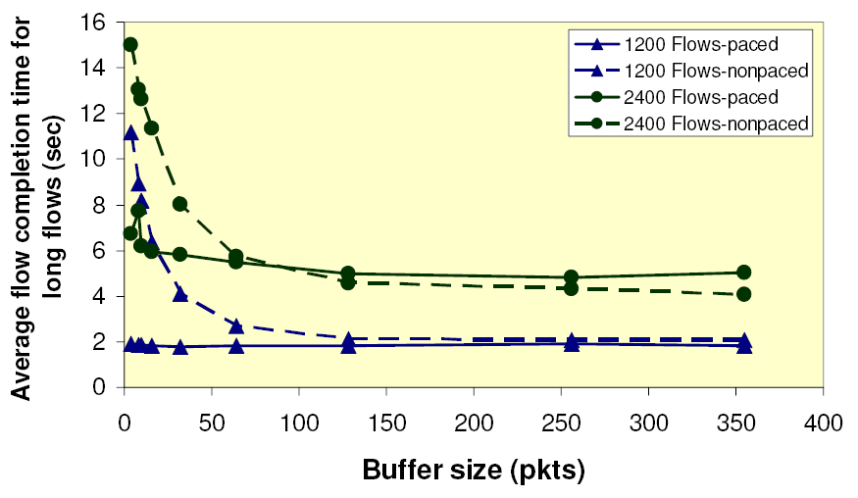
Throughput, Loss, Flow Completion Time

Slide 32
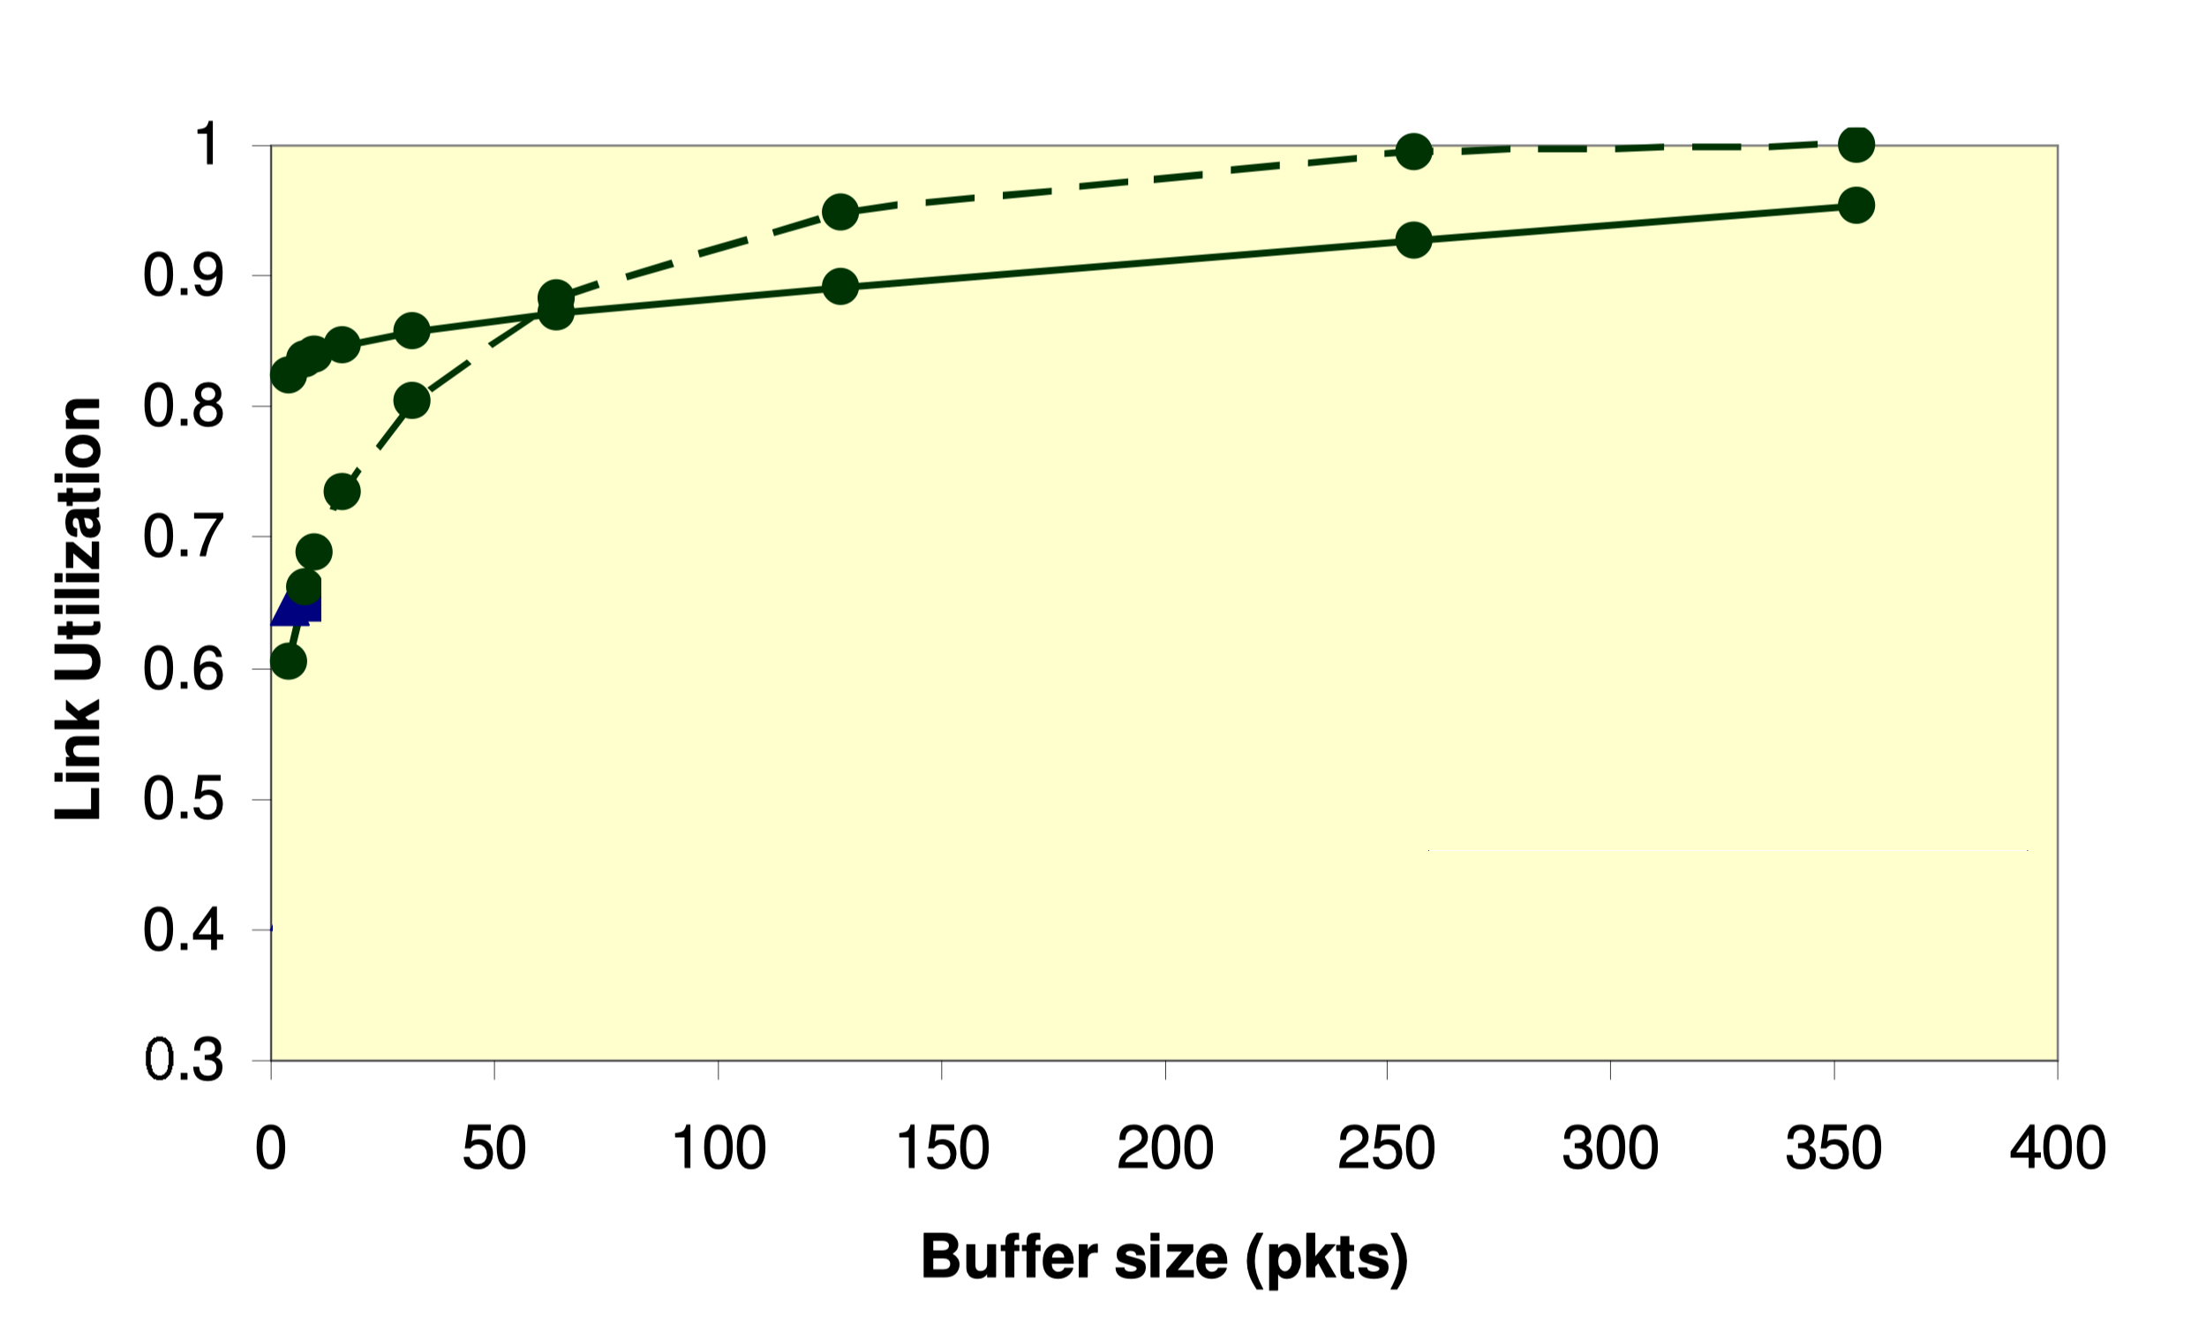
Results: Pacing and Buffer Size

Slide 33
Lessons Learned
Under the assumptions, tiny buffer results hold
Guaranteeing underlying assumptions not straightforward
  Slightest burstiness can have great impact
  Need to know network components, and how they operate
    Intel vs. Broadcom NICs
  Need to tune TCP and network stack
    TCP Offset Segmentation (TSO), Interrupt Coalescing (IC)

Slide 34
Experiment Conclusions
Small and tiny buffer experiments inline with theoretical predictions
Small buffers: no change needed
Tiny buffers: assumptions are extremely important
  Necessary to guarantee them all over the network
  We need support from network components (both software and hardware)

Slide 35

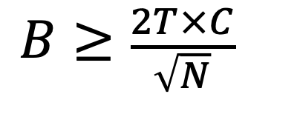
Summary
$$B≥\frac{2T×C}{\sqrt{N}}$$
$$B≥2T×C$$
100%
~ 90%
Throughput
50-100 pkts
Buffer Size

Slide 36
Some ground rules for the day
40 different experiences, 40 preconceived notions. Me too.
Let’s check preconceptions at the door: None of us know for sure.
Speakers: Please keep you to 15 minutes, including Q&A
This afternoon, two discussion sessions:
  Conclusions: What do we take away from today?
  Actions: What are the next steps?

Slide 37
Schedule for the day
10.30am – 1.30pm
Session 1: Network Operators
Neda Beheshti Facebook
Lincoln Dale Google
TY Huang Netflix
Honqqiang Liu Alibaba
Ken Duell AT&T
Joel Jaeggli Fastly
[12.00 – 12.30 Lunch]
Simon Leinen Switch
Bob Briscoe CableLabs
Chuanxiong Guo Bytedance
Igor Gashinsky Oath
1.45pm – 2.45pm
Session 2: Technology Providers
Parvin Taheri Cisco
Francois Labonte Arista
Golan Schzukin Dune/BCM
Chang Kim Barefoot
3.00pm – 4.00pm
Session 3: Discussion
  Conclusions Neda, Bruce, Nasser
  Actions and Next Steps Yashar, Nick

